Slide 1


Slide 2
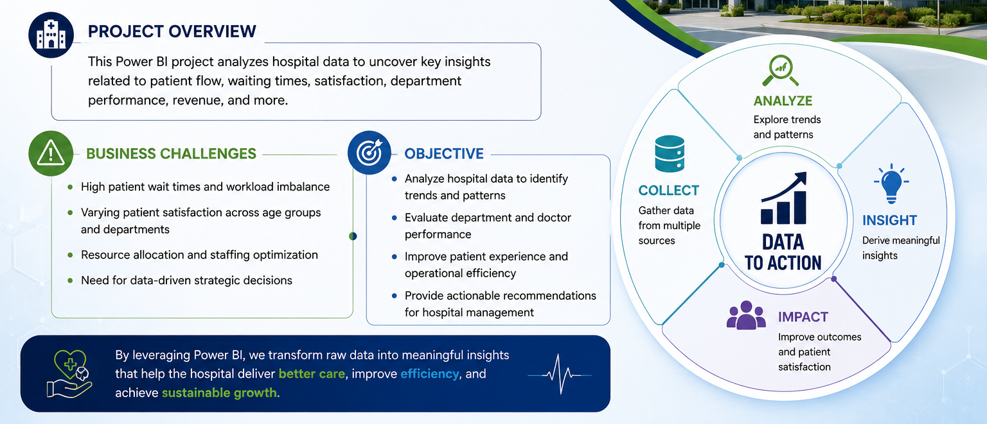
INTRODUCTION
📌 Did You Know?
Long patient waiting times and uneven hospital workload can directly reduce patient satisfaction and operational efficiency.
📊 Project Overview
This project uses Microsoft Power BI to analyze hospital emergency room and doctor-patient data to uncover operational insights and improve decision-making.
🎯 Focus Areas
Patient waiting time
Department workload
Patient demographics
Satisfaction analysis
Revenue & profitability

Slide 3
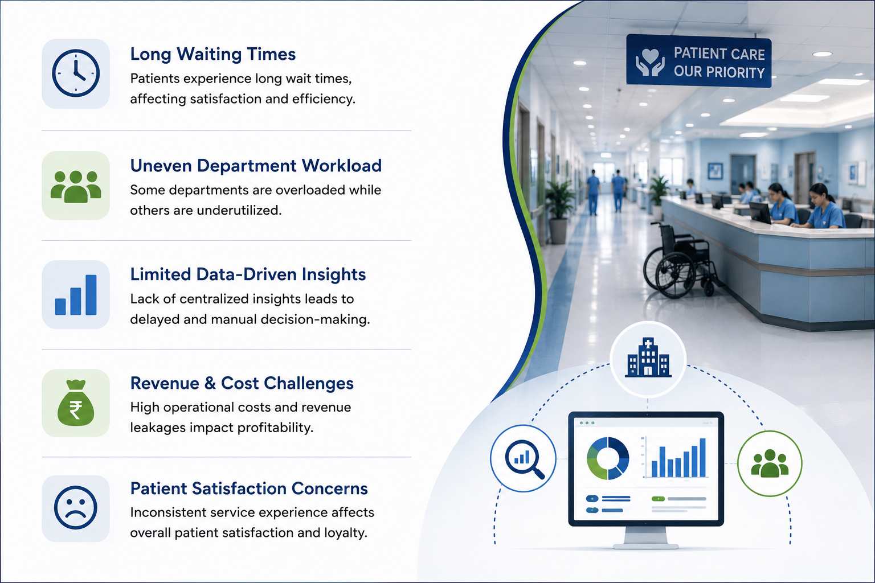
PROBLEM STATEMENT
❗ Hospital Challenges:
High patient waiting time
Uneven workload across departments
Limited visibility into hospital revenue
Need for better doctor allocation
🏥 Management Requirements
Identify overloaded departments
Improve operational efficiency
Monitor patient demographics
Analyze hospital profitability

Slide 4
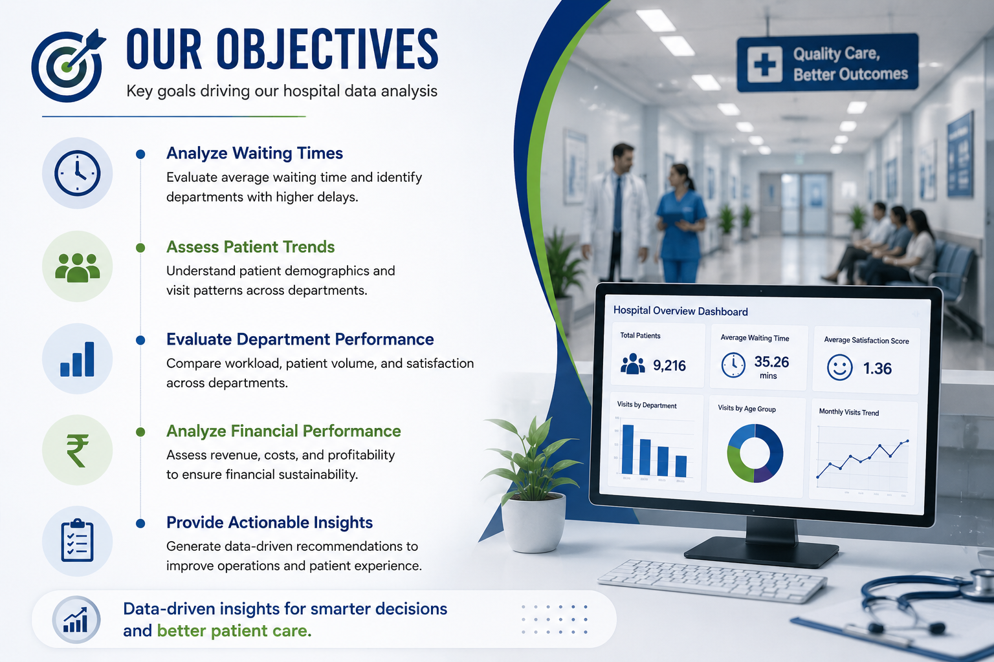
OBJECTIVE
🎯 Main Objectives:
Clean and preprocess hospital data
Analyze average waiting time
Track department-wise patient visits
Study age, gender, and race patterns
Measure patient satisfaction
📈 Advanced Objectives:
Evaluate department revenue
Analyze doctor performance
Perform SQL-based analysis
Create interactive Power BI dashboards
Generate actionable business insights

Slide 5
DATA OVERVIEW
📁 Tables Used
1️⃣ Hospital ER Data
Patient details
Waiting time
Satisfaction score
Gender & race information
Department referrals
2️⃣ Doctor Patient Data
Doctor details
Appointment fees
Total bill
Department information
📌 Key Data Points
Multiple hospital departments analyzed
Revenue and operational data included
Demographic and satisfaction analysis
🧹 Data Cleaning & Preprocessing
Removed duplicate records
Handled null/missing values
Standardized text fields
Created relationships using patient_id

Slide 6
METHODOLOGY
📊 Tools & Technologies Used
Microsoft Power BI
Power Query Editor
DAX (Data Analysis Expressions)
SQL
🔄 Analysis Workflow
Data Cleaning & Transformation
Data Type Correction
Null Value Handling
Data Modeling & Visualization
🛠 Key Features Used
Power Query Editor
KPI Cards
Table Visuals
Charts
SQL Queries

Slide 7
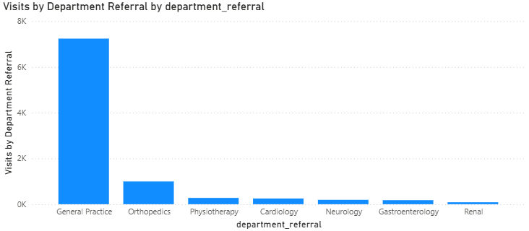
ANALYSIS OF OBJECTIVE QUESTIONS
📊 Most Visited Departments:
General Practice dominates patient visits
Indicates high demand for primary healthcare services
Requires efficient staffing & resource allocation

Slide 8
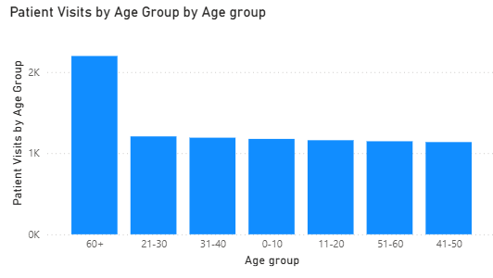
📊 Age-wise Patient Visits:
📌 Insight
Patients aged 60+ recorded the highest visits
Highlights increased healthcare needs among senior citizens

Slide 9
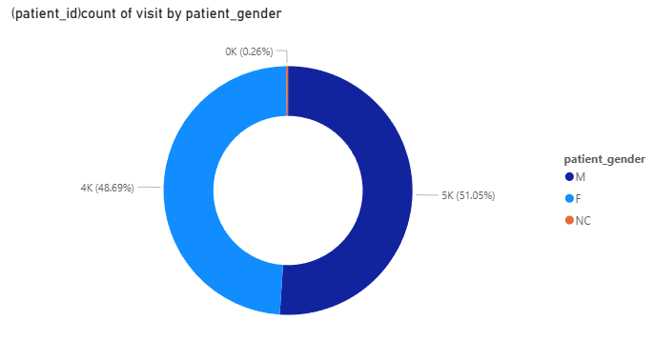
📊 Patient Visits by Gender:
📌 Insight
Male and female patient visits are nearly equal
No major gender-based difference observed

Slide 10
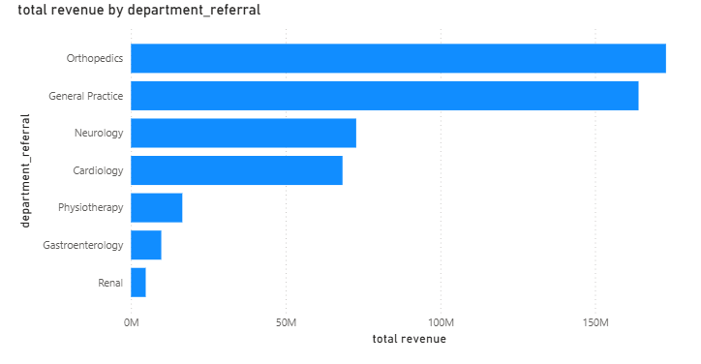
📊 Top Revenue Generating Departments:
📌 Insight
Orthopedics generated the highest revenue
General Practice contributes strongly due to high patient volume

Slide 11
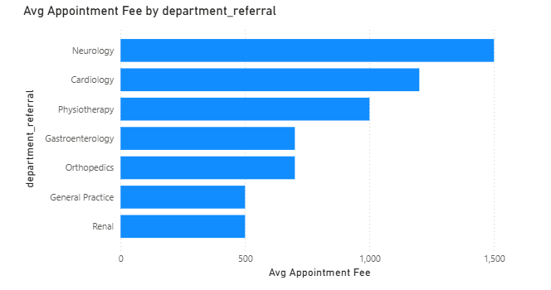
📊 Highest Average Appointment Fees:
📌 Insight
Specialized departments charge higher consultation fees
General Practice & Renal remain comparatively affordable

Slide 12
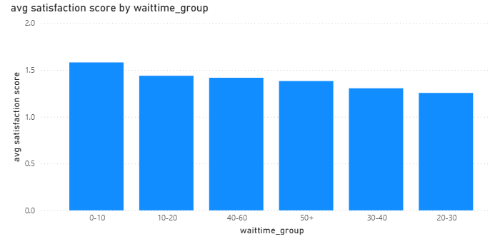
ANALYSIS OF OBJECTIVE QUESTIONS
📊 Wait Time vs Patient Satisfaction:
📈 Key Findings
Highest satisfaction in 0–10 min wait group
Satisfaction generally decreases with longer wait time
Trend shows slight fluctuations

Slide 13
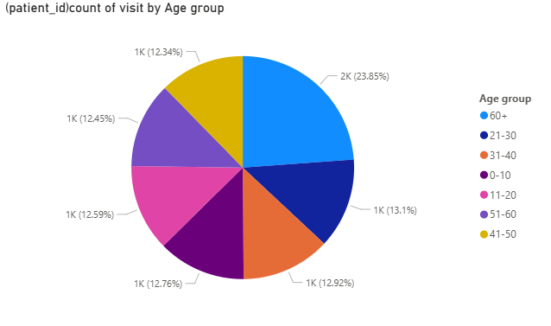
👥 Demographics & Department Visits:
📈 Key Findings
Patients aged 60+ visit most frequently
General Practice dominates across all age groups
Gender difference is minimal

Slide 14
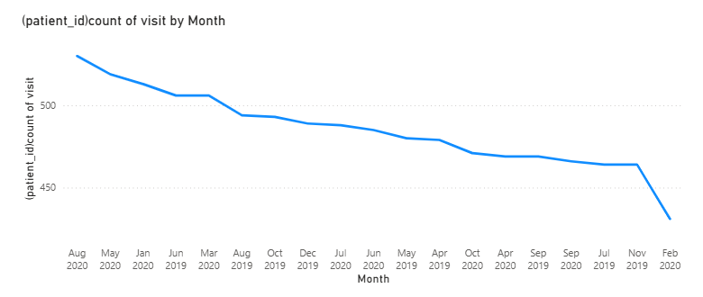
📅Patient Visit Trends Throughout the Year:
📈 Key Findings
Monthly visits remain mostly stable
Highest visits:
  Aug-20
  May-20
Lowest visits:
  Feb-20

Slide 15
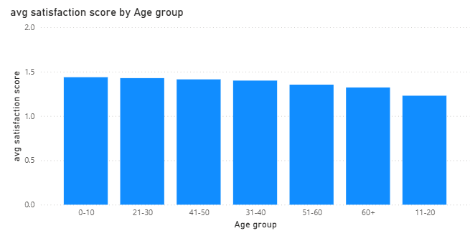
😊Satisfaction Analysis by Age Group:
📈 Key Findings
Highest satisfaction:
  Age 0–10
Lowest satisfaction:
  Age 11–20

Slide 16
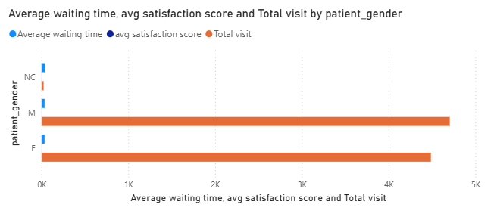
⚖️Discrimination Analysis:
📈 Key Findings
Male & female waiting times are nearly equal
Satisfaction scores show only minor variation
No race consistently received poorer service

Slide 17
STRATEGIC RECOMMENDATIONS
👨‍⚕️ 1. Hire More Doctors in General Practice:
📊 Reason
Highest patient visits (7240)
Lower satisfaction score
🎯 Expected Impact
Reduced waiting time
Improved patient satisfaction
Better workload distribution
⏱ 2. Optimize Patient Waiting Time:
📊 Reason
Average wait time = 35.26 minutes
Lower wait time improves satisfaction
🎯 Expected Impact
Faster patient service
Better hospital efficiency
Improved patient experience

Slide 18
STRATEGIC RECOMMENDATIONS
🕒 3. Implement Two-Shift System:
📊 Reason
Morning hours likely have higher patient flow
Continuous doctor availability needed
🎯 Expected Impact
Balanced doctor workload
Reduced bottlenecks
Improved patient handling capacity
💸 4. Introduce Smart Discount Policies:
📊 Reason
High-bill patients face financial burden
Long wait time affects patient experience
🎯 Expected Impact
Improved patient trust
Increased patient retention
Better service perception

Slide 19
STRATEGIC RECOMMENDATIONS
🧓 5. Strengthen Senior Citizen Healthcare Support:
📊 Reason
60+ age group recorded highest visits
🎯 Expected Impact
Better elderly care
Improved healthcare accessibility
Higher patient satisfaction
📊 6. Use Real-Time Monitoring Dashboards:
📊 Reason
Enables continuous tracking of operations
🎯 Expected Impact
Faster decision-making
Early bottleneck detection
Improved operational efficiency

Slide 20
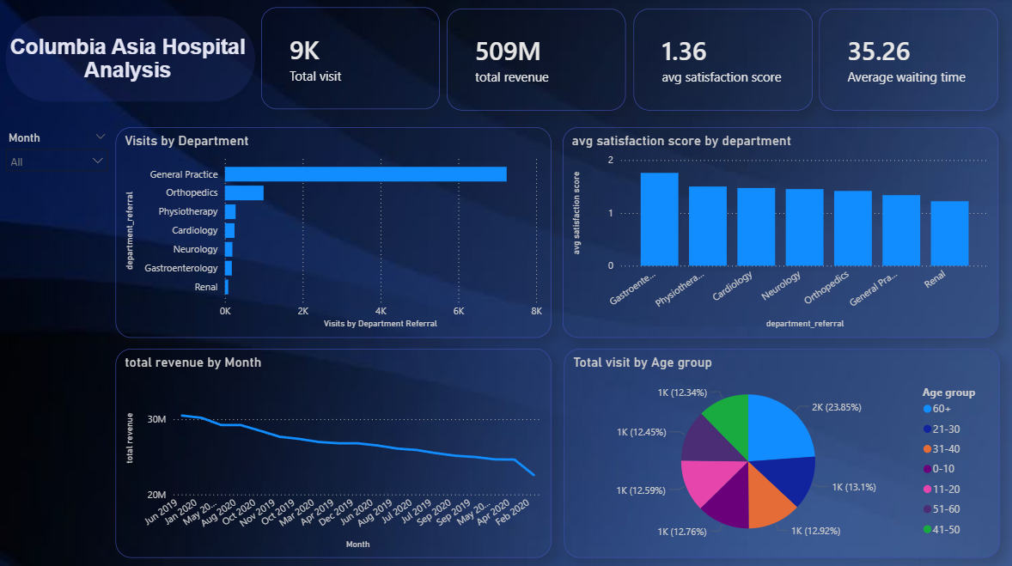
DASHBOARD AND VISUALIZATION

Slide 21
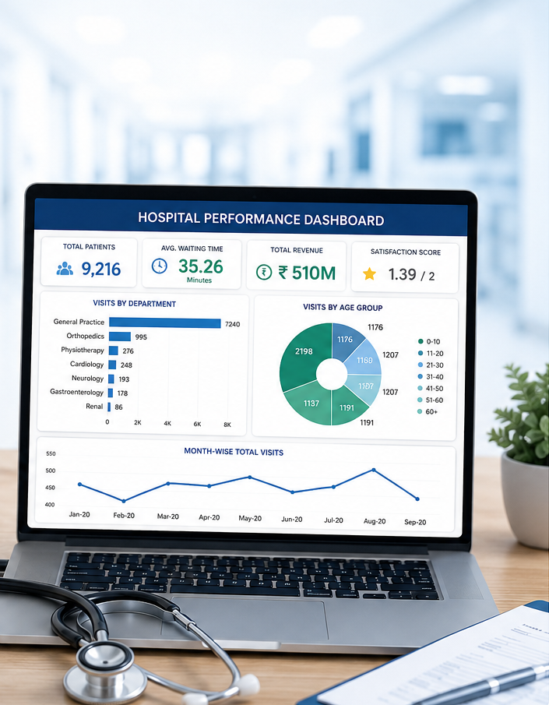
CONCLUSION
📊 Key Findings
General Practice has the highest workload
Average waiting time is 35.26 minutes
Neurology shows higher waiting time
60+ age group visits most frequently
Hospital is profitable
🚀 Recommendations
Hire more doctors in overloaded departments
Improve shift planning to reduce wait time
Use data-driven discount strategies
Monitor operations using Power BI dashboards

Slide 22


